Slide 1
Funding Perspectives from NIH, NSF, and IES: Considerations for Marginalized Identities, Under-Resourced Schools, and Emerging Scholars Society for Research on Adolescence April 19th, 2024
Chair: Velma McBride Murry, NIMH AC
Speakers:
Maggie Sweeney, NIMH
Jim Griffin, NICHD
Brett T. Spear, NIH-R16
Laura Namy, IES
Anna Fisher, NSF

Slide 2
Funding Opportunities at the National Institute of Mental Health
Maggie Sweeney, Ph.D., Program Officer
Office of Research Training and Career Development
Division of Services and Intervention Research
National Institute of Mental Health
National Institutes of Health
Society for Research on Adolescence
April 19th, 2024

Slide 3
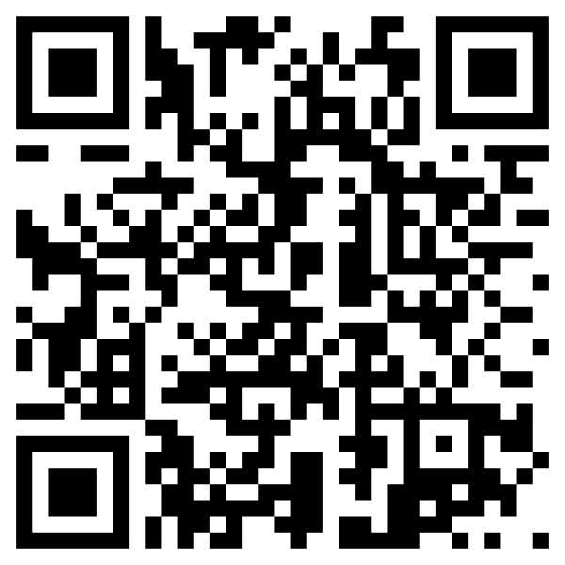
NIMH is 1 of 27 NIH Institutes and Centers (ICs)
Office of the Director
National Institute
on Aging
National Institute
on Alcohol Abuse
and Alcoholism
National Institute
of Allergy and
Infectious Diseases
National Institute
of Arthritis and
Musculoskeletal
and Skin Diseases
National Cancer
Institute
National Institute
of Child Health
and Human
Development
National Institute on
Deafness and Other
Communication
Disorders
National Institute
of Dental and
Craniofacial
Research
National Institute
of Diabetes and
Digestive and
Kidney Diseases
National Institute
on Drug Abuse
National Institute
of Environmental
Health Sciences
National Eye
Institute
National Institute
of General
Medical Sciences
National Heart,
Lung, and Blood
Institute
National Human
Genome Research
Institute
National Institute
of Mental Health
National Institute
of Neurological
Disorders and
Stroke
National Institute
of Nursing Research
National Center
for Complementary
and Alternative
Medicine
Fogarty
International
Center
National Center
for Research
Resources
National Library
of Medicine
National Institute of
Biomedical Imaging
and Bioengineering
National Center on
Minority Health and
Health Disparities
Clinical Center
Center for
Information
Technology
Center for
Scientific Review
https://www.nih.gov/institutes-nih

Slide 4
Typical IC Organizational Structure
National Advisory Council
Office of the Director
Board of Scientific Advisors
Extramural Research
Intramural Research
Scientific Programs & Divisions
Laboratory Studies
Clinical Studies
Program
Review
Grants Management

Slide 5
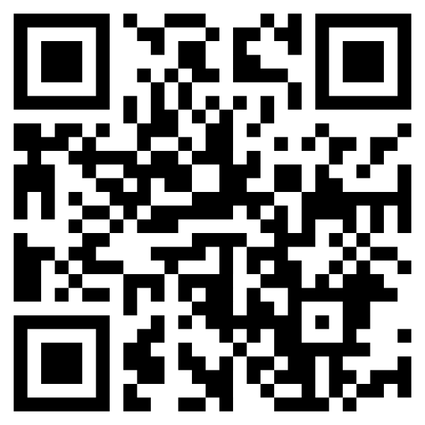
Resources to Find the Right IC and PO
Talk to mentors and colleagues
Search NIH RePORTER for funded projects
Search NIH Matchmaker for similar projects and POs
Review notices of funding opportunity (NOFOs):
Grants.gov or IC website
Subscribe to the NIH Guide for Grants and Contracts
PA, PAR, PAS, RFA, NOSI (Look for “Scientific Contact”)
Contact a Program Officer with a draft Specific Aims page or concept paper describing your research plans
Review IC webpages, missions, strategic plans, & research priorities
Subscribe to the NIH Guide for Grants

Slide 6
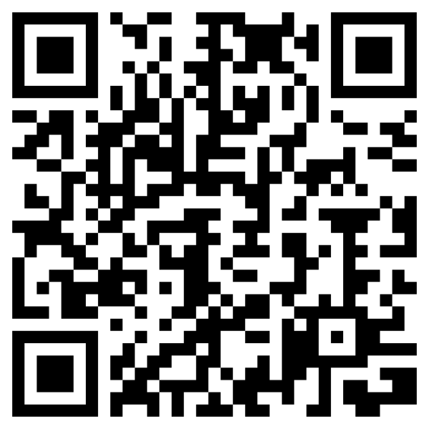
NIMH Strategic Plan Goals
https://www.nimh.nih.gov/about/strategic-planning-reports

Slide 7
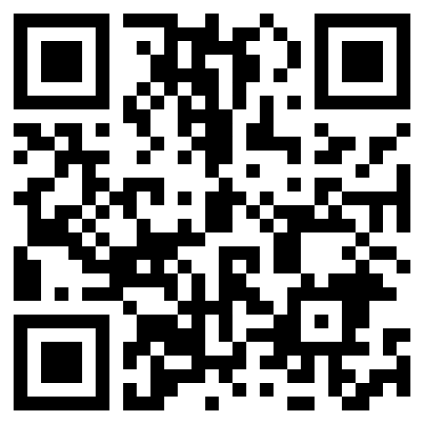
NIH Supports Training Across Career Stages
Training and career development awards emphasize establishing scientific expertise through mentored research, didactic trainings, and professional development activities.
NIH Training:
https://researchtraining.nih.gov/programs/career-development
NIMH Training:
https://www.nimh.nih.gov/funding/training

Slide 8
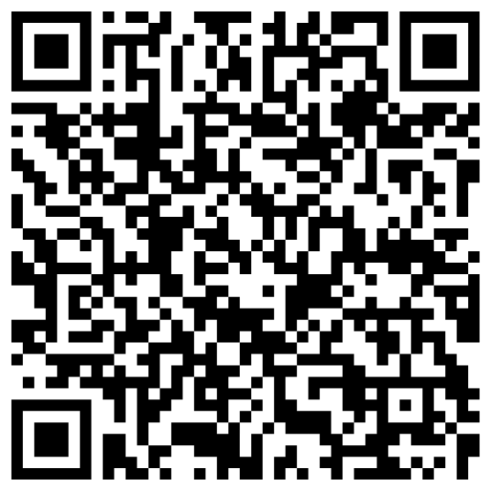
Workforce Diversity
See NIMH Office for Disparities Research and Workforce Diversity (ODWD) for more information
Pre-Doctoral Awards
NRSA Individual Fellowships to Promote Diversity (F31-Diversity)
Mental Health Dissertation Grant to Enhance Workforce Diversity (R36)
Blueprint and BRAIN Initiative Diversity Predoc to Postdoc Advancement in Neuroscience (D-SPAN) (F99/K00)
Postdoctoral/Career Development Awards
BRAIN Initiative Postdoctoral Career Transition Award to Promote Diversity (K99/R00)
MOSAIC Career Transition Award to Promote Diversity (K99/R00)
Research Supplements to Promote Diversity in Health-Related Research
Supplement application and review procedures
Notice of Funding Opportunity
Faculty level and institutional awards are also available
Research Opportunities for New and "At-Risk" Investigators to Promote Workforce Diversity (R01)
STrengthening Research Opportunities for NIH Grants (STRONG): Structured Institutional Needs Assessment and Action Plan Development for Resource Limited Institutions (UC2)
Current funding opportunities: https://www.nimh.nih.gov/about/organization/od/odwd/funding-opportunities-for-research-on-disparities-and-workforce-diversity

Slide 9
Take home messages
NIH supports research across career stages
There are many predoctoral, postdoctoral, and early career opportunities
Review Grants.gov, Institute or Center (IC) websites, or Subscribe to the NIH Guide for Grants and Contracts to learn about current opportunities
Talk to your mentors, and use the NIH RePORTER and Matchmaker to find the right IC and Program Officer
You can also look at the “Scientific Contact” in a funding notice to find a PO
Review the IC’s Strategic Plan (e.g., NIMH)
Read more about NIH’s interest in diversity: https://extramural-diversity.nih.gov/diversity-matters
Reach out to a Program Officer via email with a Specific Aims page or concept paper prior to submission

Slide 10
Questions?
Maggie Sweeney, Ph.D.
Program Officer
maggie.sweeney@nih.gov
nimh.nih.gov
https://www.nimh.nih.gov/about/careers
Follow NIMH on Social Media @NIMHgov

Slide 11
Opportunities for Federal Research Funding at NICHD
James A. Griffin, PhD
Society for Research on Adolescence
April 19, 2024

Slide 12
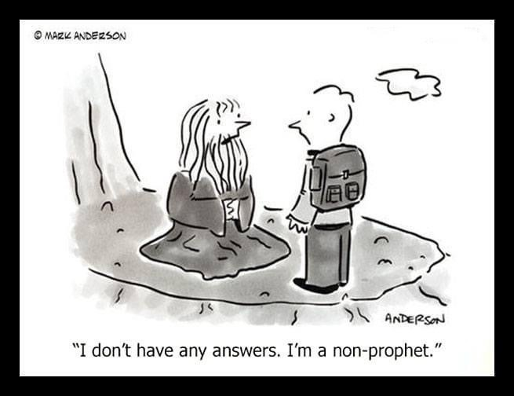

Slide 13
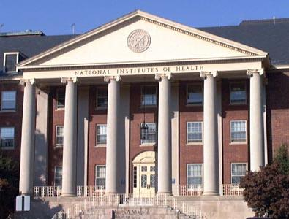
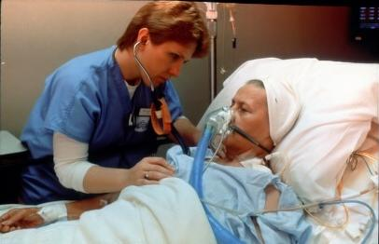
The National Institutes of Health The Nation’s Steward of Medical, Behavioral, and Social Sciences Research
“Science in pursuit of fundamental knowledge about the nature and behavior of living systems
...
and the application of that knowledge to enhance health, lengthen life, and reduce illness and disability.”
Notes:
[Animated, 1 click]

Slide 14
National Institutes of Health
World’s largest supporter of biomedical, behavioral, and social science research and training.
~$49.1 Billion budget (FY2024)
27 Institutes and Centers
Notes:
Brett

Slide 15
NICHD Mission Statement
Lead research and training to understand human development, improve reproductive health, enhance the lives of children and adolescents, and optimize abilities for all.
“Healthy pregnancies. Healthy children. Healthy and optimal lives.”

Slide 16
NICHD Branches with SRA Interests
Population Dynamics Branch (PDB) https://www.nichd.nih.gov/about/org/der/branches/pdb
Intellectual & Developmental Disabilities Branch (IDDB) https://www.nichd.nih.gov/about/org/der/branches/iddb/Pages/overview.aspx
Pediatric Growth and Nutrition Branch (PGNB) https://www.nichd.nih.gov/about/org/der/branches/pgnb/Pages/overview.aspx
Pediatric Trauma & Critical Illness Branch (PTCIB) https://www.nichd.nih.gov/about/org/der/branches/ptcib/Pages/overview.aspx
National Center for Medical Rehabilitation Research (NCMRR) https://www.nichd.nih.gov/about/org/ncmrr/Pages/overview.aspx
Notes:
These URLs will take you to the Branch’s description & priorities.

Slide 17
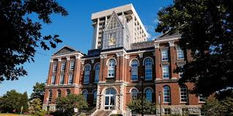
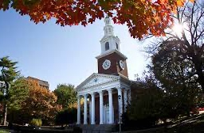
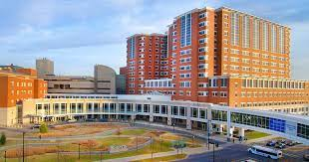
Society for Research on Adolescence
2024 Annual Meeting
Chicago, Illinois
Friday, April 19
NIH SuRE Program & Support
via the University of Kentucky SuRE Resource Center
Brett Spear, PhD
Co-Director, SuRE Resource Center
University of Kentucky College of Medicine
Funding for this presentation was made possible by U24 GM146576 from NIGMS. The views expressed by speakers do not necessarily reflect the official policies of the Department of Health and Human Services; nor does mention by trade names, commercial practices, or organizations imply endorsement by the U.S. Government.

Slide 18
R16 Grants
Used to support research capacity building at eligible higher education institutions through funding investigator-initiated research in the biomedical, clinical, behavioral, and social sciences that falls in the mission areas of the NIH.
1.
2.
3.
Research grant support to establish or continue research programs at R16-eligible institutions
Provide students with meaningful research opportunities to support their matriculation into biomedical careers
Catalyze institutional research and enrich the overall research environment at R16-eligible institutions

Slide 19
R16 GRANTS
The SuRE Program accepts proposals of a wide variety – both biomedical and behavioral science focused
Meritorious science will be considered for funding by NIGMS & the other 18 participating Institutes/Centers (ICs)
Two active R16 NOFOs are available to applicants (no Clinical Trials allowed)
Standard SuRE R16 (for established investigators) – PAR-24-144
SuRE-First R16 (for new investigators; mentored award) – PAR-24-145
Two submission deadlines are available for R16 grants
2024 – Spring (May 29); Fall (Sept 27)
2025 – Spring (May 28); Fall (Sept 29)
2026 – Spring (May 27); Fall (Sept 28)

Slide 20
INSTITUTIONAL
ELIGIBILITY
1. Required Degree Offerings
Must be an academic institution of higher education that offers Bachelor and/or graduate degrees in the biomedical sciences.
And…
>25% Pell grant aid in either All undergraduate students, OR Full-time, first-time, degree/certificate-seeking undergraduate students, you meet this institutional eligibility criteria
And…
Less than $6 million in RPG funding for each of the last two fiscal years, you meet this institutional eligibility criteria AND hold no more than 20 SC1, SC3 and/or R16 grants
2. Pell Grant Recipient Threshold
3. NIH RPG Funding Threshold

Slide 21
PD/PI ELIGIBILITY
The SuRE mechanism is open to tenure-track (or equivalent) faculty applicants with* prior research experience but are not currently funded by NIH RPG grant(s).
Exception - applicants with SCORE or SuRE awards in their final year
Holding a co-Investigator role does not negate eligibility
Effort commitment should match needs of the proposed project
The SuRE-First mechanism is open to tenure-track (or equivalent) faculty applicants with no prior independent external research grants as PD/PI.
Holding a co-Investigator role does not negate eligibility
Must commit >6 person months effort/project year*
Must identify a US-based scientist(s) with relevant expertise and research funding to serve as a mentor(s)
*Those who meet SuRE-First eligibility, but are unable to commit 6 months of effort may also apply for SuRE

Slide 22
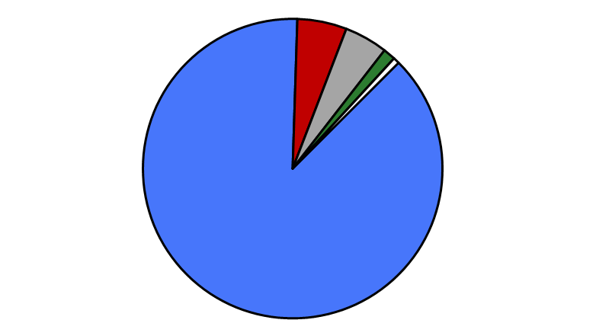
R16 FUNDING
Currently, 150 Active R16s
Active R16 Award Distribution by IC
Currently, R16 proposal number is relatively low and success rates are high (>40%)
Keep in mind, that as awareness of the program grows, there maybe shifts in success rates
The UK SuRE Resource Center is available to assist those at R16-eligible institutions
Other ICs
12%
NIGMS
88%
NIAID 5.3%
NINDS 4.7%
NEI 1.3%
NIA 0.7%
NIH FY23 Funding Data: https://report.nih.gov/funding/nih-budget-and-spending-data-past-fiscal-years/success-rates
Funded R16s: https://reporter.nih.gov/search/j635rG2P6UqXuM-URfxpjw/projects

Slide 23
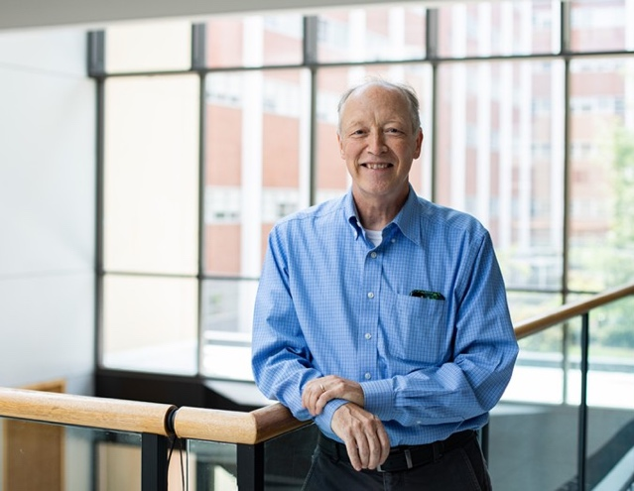
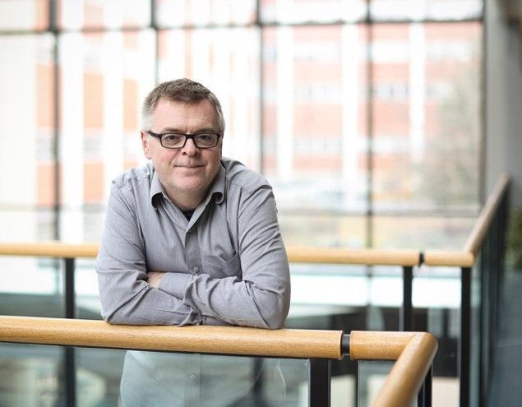
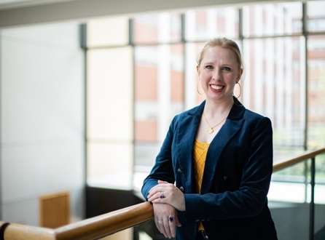
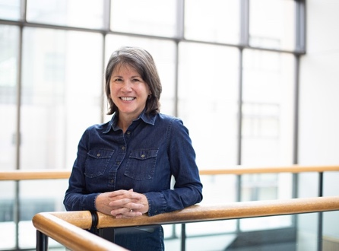
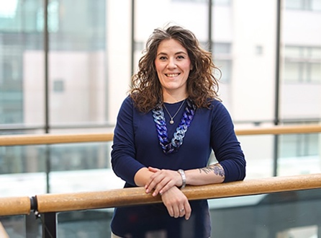
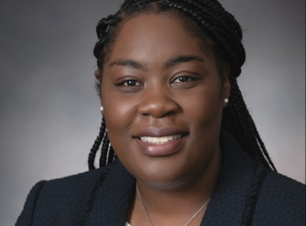
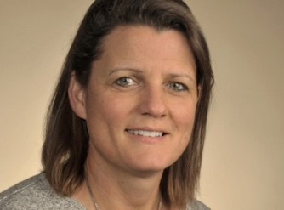
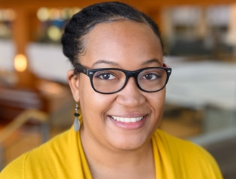
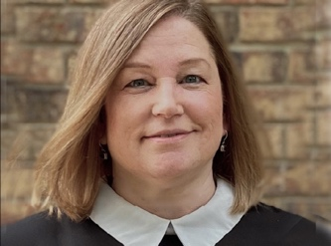
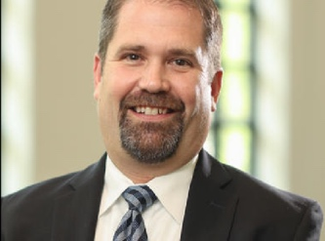
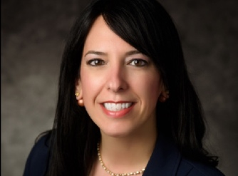
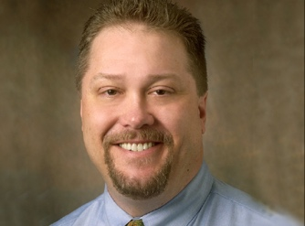
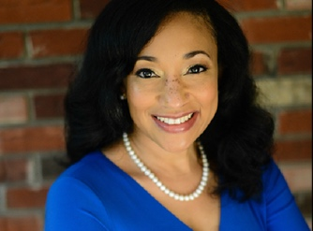
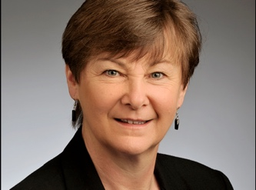
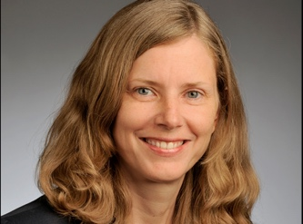
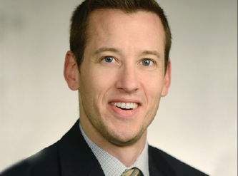
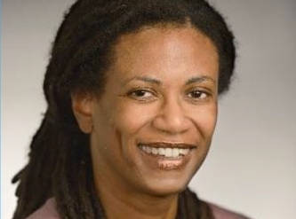
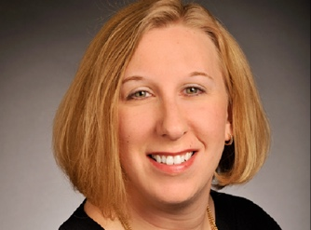
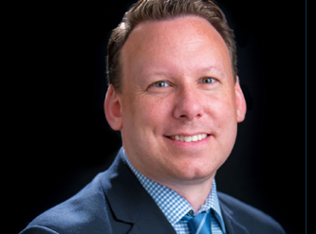
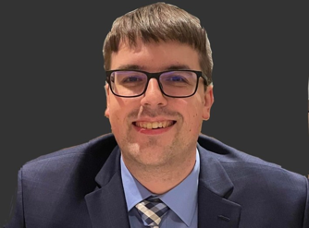
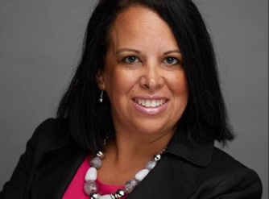
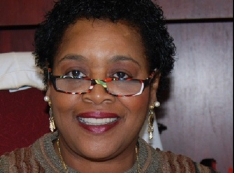
Brett Spear, PhD
M. Paul Murphy, PhD
University of Kentucky
SuRE Resource Center
Our Center, supported by an NIH U24 grant, provides activities to educate faculty and research administrative staff in the NIH funding process and to foster a national SuRE community. Research experts cover the writing and managing of grants while working closely with applicants as they progress toward their submissions. For institutions committed to building their Office of Sponsored Projects (OSP), competitive seed grant money is available to facilitate those efforts.

Slide 24
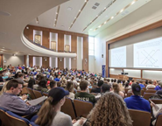
SUPPORT
OUTREACH & TRAINING
Conference engagements
Bi-monthly webinar training series
Bi-annual R16 application bootcamps (virtual)
On-demand access to trainings via the Center’s YouTube channel
OSP SEED GRANTS
Financial support to improve research capacity at R16-eligible institutions ($250K/year)
Awarded via a competitive, application-based process
Not intended to support faculty, however
CONSULTATIONS
Consultation on eligibility issues
Specific Aims draft review and feedback from an NIH-funded investigator
Answers to questions on other elements of R16 applications
SuRE BIENNIAL CONFERENCE
Share your science
Research development/administrative sessions
Networking opportunities
Strong participation of staff from various NIH ICs

Slide 25
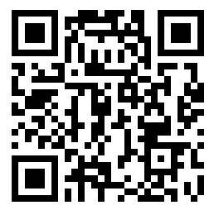
THANK YOU! QUESTIONS?
https://www.research.uky.edu/sure-resource-center
SuRE.RC@uky.edu
SuRE Resource Center
@SuRE_RC
@SuRE_RC

Slide 26
Institute of Education Sciences (IES) Funding Opportunities: Broadening Participation
Laura L. Namy
Associate Commissioner for Teaching and Learning
National Center for Education Research
Laura.Namy@ed.gov

Slide 27
IES Mission
Describe the condition of American education
Provide scientific evidence to inform education practice and policy
Share this evidence with a wide range of stakeholders through varied formats that are useful and accessible to different audiences (educators, parents, policymakers, researchers, and the public)

Slide 28
Four IES Centers Contribute to This Mission
Organizational Structure
National Center for Education Statistics
National Center for Education Research
National Center for Education Evaluation and Regional Assistance
National Center for Special Education Research

Slide 29
NCER and NCSER
NCER supports field-initiated research to
Expand understanding of learners from PreK through postsecondary and adult education
Improve academic achievement and attainment and access to educational opportunities for all learners, with a particular focus on low-performing learners and those lacking access to high-quality educational opportunities
NCSER supports field-initiated research to
Expand knowledge and understanding of the needs of infants, toddlers, children, and youth with disabilities in order to improve their developmental, educational, and transitional results
Improve services provided under, and support and evaluate the implementation of, the Individuals with Disabilities Education Act

Slide 30
Strong Commitment to Building Capacity and Broadening Participation
Institution Type and Geographic Region
PI Backgrounds and Career Stages
Topical issues
Methodological Approaches

Slide 31
Research Topics
Special Education Research | Education Research
Cognition and Student Learning Early Intervention and Early Learning Educators and School-Based Service Providers Reading, Writing, and Language STEM Social, Emotional, and Behavioral Competence Systems, Policy, and Finance Transition to Postsecondary Education, Career, and/or Independent Living Families of Learners with Disabilities | Career and Technical Education Civics Education and Social Studies Cognition and Student Learning Early Learning Programs and Policies English Learner Policies, Practices, and Programs Improving Education Systems Literacy Social, Emotional, and Behavioral Context for Teaching and Learning Postsecondary and Adult Education STEM Education Teaching, Teachers, and the Education Workforce
31

Slide 32
Project Types
Measurement: develop/refine and/or validate a new or existing measure
Exploration: identify relationships between learner-, educator-, school-, and policy-level characteristics and meaningful education outcomes
Development and Innovation: develop/modify an intervention and test its feasibility and promise for improving learner outcomes
Impact: evaluate whether an intervention that hasn’t been tested prior shows efficacy, conduct longer-term follow-up of a rigorously-evaluated intervention, or conduct replication studies that systematically vary one or more aspects of a previous study (e.g., geographical location, population) and contribute to a better understanding of what works, for whom, and under what conditions
“What works for whom under what conditions?”
32

Slide 33
IES Research Training Programs
NCSER (84.324B):
Postdoctoral Research Training in Special Education and Early Intervention
Early Career Development and Mentoring Program for Special Education Research
Methods Training for Special Education Research
NCER (84.305B):
Pathways to the Education Sciences
Predoctoral Interdisciplinary Research Training in the Education Sciences
Postdoctoral Research Training in the Education Sciences
Early Career Development and Mentoring Program for Education Research
Early Career Mentoring Program for Faculty at Minority-Serving Institutions (MSIs)
Methods Training for Education Research

Slide 34
IES Early Career Development and Mentoring Programs
Provides support for new investigators to conduct an integrated research and training plan under the guidance of experienced researcher mentors
NCER Early Career Programs in the Education Sciences:
Early Career Development and Mentoring Program for Education Research (new): for researchers at academic or nonacademic institutions.
Early Career Development and Mentoring Program for Faculty at Minority-Serving Institutions (MSIs): for researchers at MSIs
NCSER Early Career Programs in Special Education: for researchers at academic institutions to do research related to learners with or at risk for disabilities
34

Slide 35
Connect With Your IES Program Officer
The best time to build a relationship with a program officer is early in the process
IES POs can help you identify relevant funding opportunities, refine your ideas, dispel myths, review drafts, and discuss feedback received from reviewers
Discuss your research idea with a program officer
Email a short synopsis or a questions
The PO may redirect you to someone more familiar with your interests
Work with the PO(s) to schedule a time for a call

Slide 36
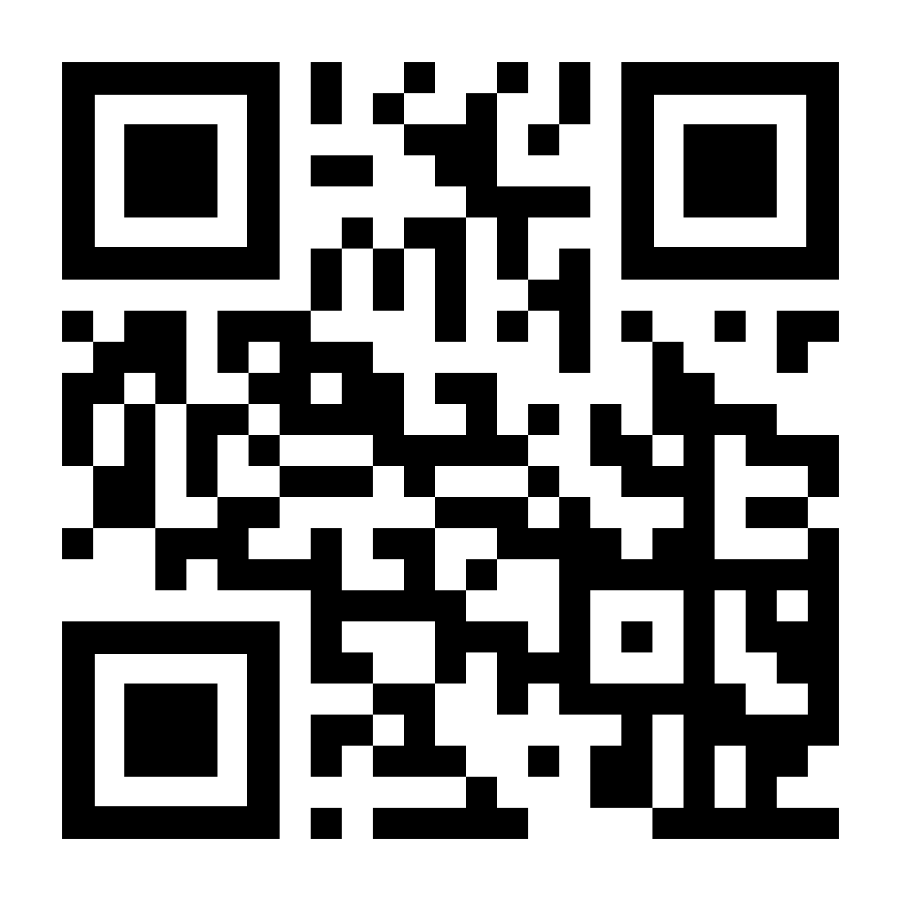
How to Identify Funding Opportunities
Sign up for the IES Newsflash (https://ies.ed.gov/newsflash/#ies)
Check for funding opportunities announcements in the Federal Register (https://www.federalregister.gov/)
Find the funding opportunities page of the IES website (https://ies.ed.gov/funding)
Review current Requests for Applications (RFAs) and the Application Submission Guide
Contact relevant Program Officer(s)
36
36

Slide 37
Thank you! Laura L. Namy, Associate Commissioner Laura.Namy@ed.gov Newsflash: https://ies.ed.gov/newsflash/#ies Blog: https://ies.ed.gov/blogs/ X: @IESResearch Facebook: https://www.facebook.com/IESResearch/

Slide 38
Key Components/Requirements of IES Early Career Programs
Principal Investigator (PI)
Must be within 5 years of finishing doctoral degree or postdoc at the time of applying
Must have an eligible position at an eligible institution (differs by program)
Must be a citizen or permanent resident of the U.S.
Has not been a PI or Co-PI on an IES grant
Mentors
At least one must be from home institution
Must not have been the PI’s dissertation advisor or postdoc supervisor
Can be from academic or nonacademic institutions
Research
Aligned with 1-2 research topics and 1 project type
Includes a balance of activities/methods PI has experience with and those that are new and part of the career development plan
Career Development
Centered around 3-4 goals that are aligned with the research and address gaps in the PI’s knowledge and training/areas the PI wants to grow
Includes mentoring and other training activities
38

Slide 39
Standards for Excellence in Education Research (SEER) https://ies.ed.gov/seer
Pre-register studies
Make research findings, methods, and data available to others
Address inequities in learners' opportunities, access to resources, and outcomes
Identify core intervention components
Document intervention implementation and contrast to inform use in other settings
Analyze costs
Focus on outcomes meaningful to learners’ success
Facilitate generalization of study findings
Conduct research in a way that informs the future scaling of interventions

Slide 40
New and Ongoing Diversity Initiatives at the National Science Foundation
Anna Fisher
Program Director
Developmental Sciences Program
Division of Behavioral and Cognitive Science
Directorate for Social, Behavioral, and Economic Sciences
avfisher@nsf.gov

Slide 41
NSF: Brief Introduction
The U.S. National Science Foundation is an independent federal agency that supports science and engineering in all 50 states and U.S. territories.
NSF was established in 1950 by Congress to:
Promote the progress of science.
Advance the national health, prosperity and welfare.
Secure the national defense.
NSF investments account for ~25% of federal support to America's colleges and universities for basic research.
Notes:
https://new.nsf.gov/about#what-we-support-b2a

Slide 42
NSF/SBE Initiatives to Increase Diversity
Agency-wide
Directorate-level (Social, Behavioral & Economic Sciences)
Program-level (Developmental Sciences)
DCLs (initiatives)

Slide 43
New Awards 2020-2024
Notes:
https://new.nsf.gov/about/about-nsf-by-the-numbers
Notice that lots of awards go to highly populous states, uneven investment in research across the country

Slide 44
EPSCoR Jurisdictions Map
Notes:
The enhanced focus on NSF funding in EPSCoR jurisdictions is to aid in addressing the Missing Millions – individuals, communities, and institutions who are not yet engaged in the STEM workforce leading to great disparity in racial, ethnic, and gender representation of the general population in STEM fields

Slide 45
Build and Broaden (SBE)
The Build and Broaden program within the SBE directorate supports fundamental SBE research and research capacity at minority-serving institutions
Partnerships can be with or among MSIs
Proposals that outline research projects in SBE sciences that increase students’ pursuit of graduate training, enhance PI productivity, build research capacity, or cultivate partnerships are especially encouraged

Slide 46
Science of Broadening Participation (SBE)
The Science of Broadening Participation uses the theories, methods, and analytic techniques of the SBE and learning sciences to understand factors that enhance as well as barriers that hinder our ability to expand participation in education, the workforce, and major social institutions
Submit through core program but indicate appropriate for SBP
SBE Postdoctoral Research Fellowship Program includes a Broadening Participation track: it offers fellowships to increase the diversity of post-doctoral level researchers, specifically increase the participation of scientists from underrepresented groups

Slide 47
Developmental Sciences Program (SBE): New Program Solicitation
New program solicitation introduces new requirements for proposals, including:
The program seeks to support research that (1) involves diverse methodologies and theoretical perspectives; (2) includes participants from a range of communities, ethnicities, socioeconomic backgrounds, and cultures; and (3) helps diversify research project leadership (PIs and co-PIs), ideas, and approaches via equity-centered collaborative models. Proposals that include participants from historically marginalized groups and/or groups underrepresented in developmental science research should demonstrate cultural competence within the research team to conduct research with these communities. PIs should provide clear evidence of equity-centered collaborative practices with community members.

Slide 48
Dear Colleague Letters (DCLs)
Dear Colleague Letters (DCLs) are public communications that can announce new initiatives, programs, supplements and may communicate funding priorities
Stimulating Diversification in Language Science Research (LangDiv)
STEM Access for Persons with Disabilities (STEM-APWD)
Research Opportunity Award: Supplement Opportunity (ROA)
The Social and Behavioral Science of Bias, Prejudice and Discrimination (BPD)

Slide 49
LangDiv

Slide 50
STEM-APWD

Slide 51
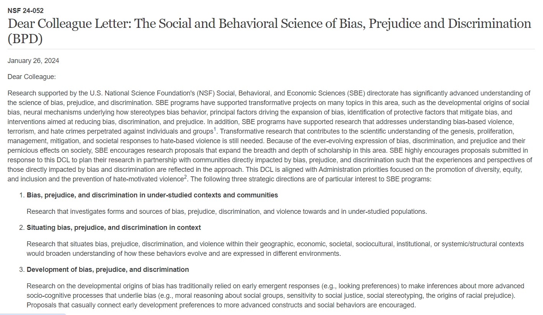
Social and Behavioral Science of Bias, Prejudice and Discrimination (BPD)

Slide 52
What Can You Do?
Be a partner: build collaborative proposals; use supplements; build networks
Invite NSF POs to outreach events
Participate in proposal review process (ad-hoc and panel)
Become an NSF rotator

Slide 53
Questions? Come talk to me!
Anna Fisher
avfisher@nsf.gov

